Slide 1
DevOps

Slide 2
Introduction to DevOps
Software Development
DevOps Life Cycle
DevOps Tools
DevOps Stages

Slide 3


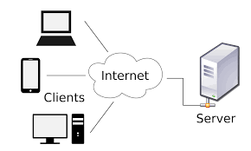





DAWN OF DEVOPS
++
++
++
Development + Operations
Notes:
In the picture it is now clearly evident that work that happens on the software is handled by the Development team and the work that happens on the software systems is handled by the Operations team.

Slide 4
WHAT IS DEVOPS
Amalgamation of words
Development
Operations
Development Team
Representing software programmers, software testers, quality assurance
Operations Team
Experts who put software into production, system administrators, Network administrators, DBAs
Notes:
These are some common on the face value understanding of DevOps. DevOps – is written with D and O caps implying an importance of both Development and Operations team.
Note the usage of the term Development Team : it comprises of both programmers, tests and QA teams.

Slide 5
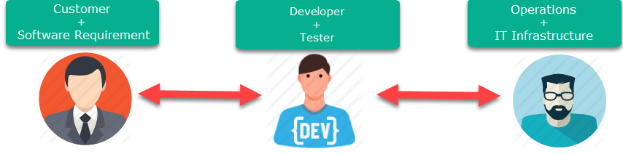
Software Development

Slide 6
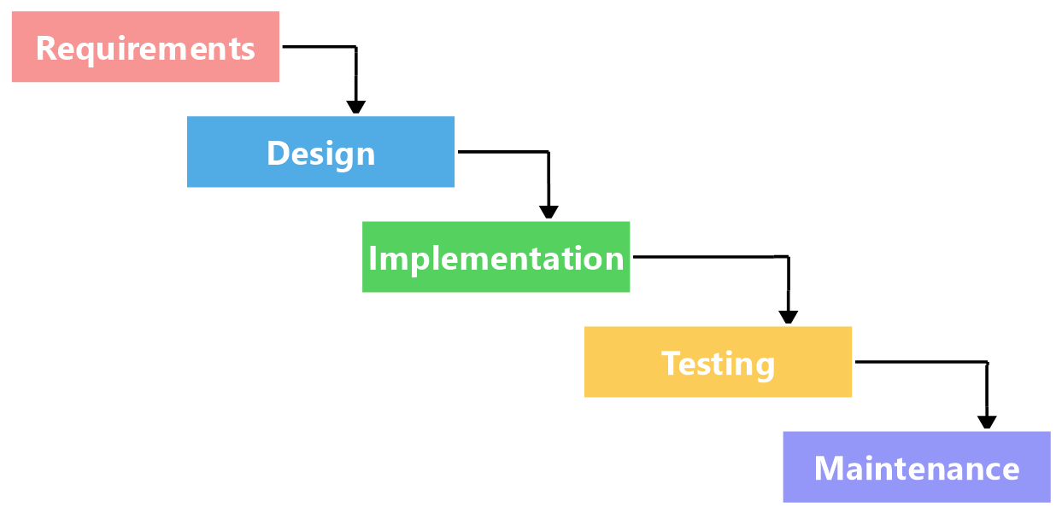
Waterfall Model

Slide 7
Waterfall Model Drawback
The major disadvantages of the Waterfall Model are as follows −
No working software is produced until late during the life cycle.
Not a good model for complex and object-oriented projects.
Not suitable for the projects where requirements are at a moderate to high risk of changing. So, risk and uncertainty is high with this process model.
Cannot accommodate changing requirements.
Integration is done as a "big-bang. at the very end, which doesn't allow identifying any technological or business bottleneck or challenges early.

Slide 8
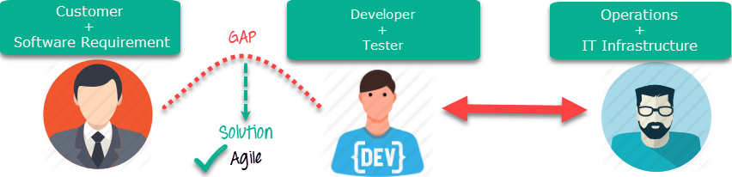
Agile Advantage

Slide 9
Agile Development Methodology
Agile SDLC model is a combination of iterative and incremental process models with focus on process adaptability and customer satisfaction by rapid delivery of working software product.
Agile Methods break the product into small incremental builds. These builds are provided in iterations.
Each iteration typically lasts from about one to three weeks.
Every iteration involves cross functional teams working simultaneously on various areas

Slide 10
Agile Development Methodology
The advantages of the Agile Model are as follows −
Is a very realistic approach to software development.
Promotes teamwork and cross training.
Functionality can be developed rapidly and demonstrated.
Delivers early partial working solutions.
Gives flexibility to developers.

Slide 11
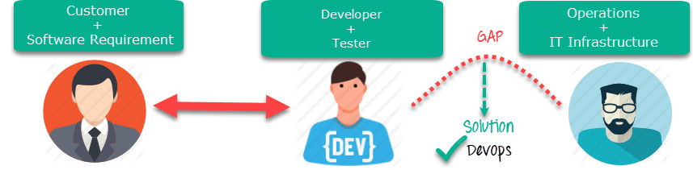
DevOps Advantage

Slide 12
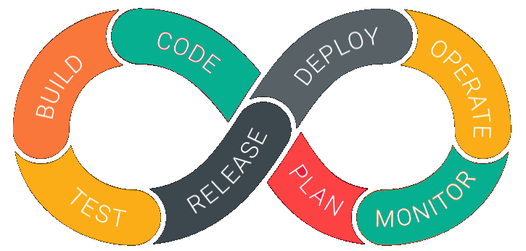
DevOps LifeCycle

Slide 13
DevOps LifeCycle
1. Development
In this DevOps stage the development of software takes place constantly. In this phase, the entire development process is separated into small development cycles. This benefits DevOps team to speed up software development and delivery process.
2. Testing
QA team use tools like Selenium to identify and fix bugs in the new piece of code.
3. Integration
In this stage, new functionality is integrated with the prevailing code, and testing takes place. Continuous development is only possible due to continuous integration and testing.

Slide 14
DevOps LifeCycle
4. Deployment
In this phase, the deployment process takes place continuously. It is performed in such a manner that any changes made any time in the code, should not affect the functioning of high traffic website.
5. Monitoring
In this phase, operation team will take care of the inappropriate system behaviour or bugs which are found in production.

Slide 15
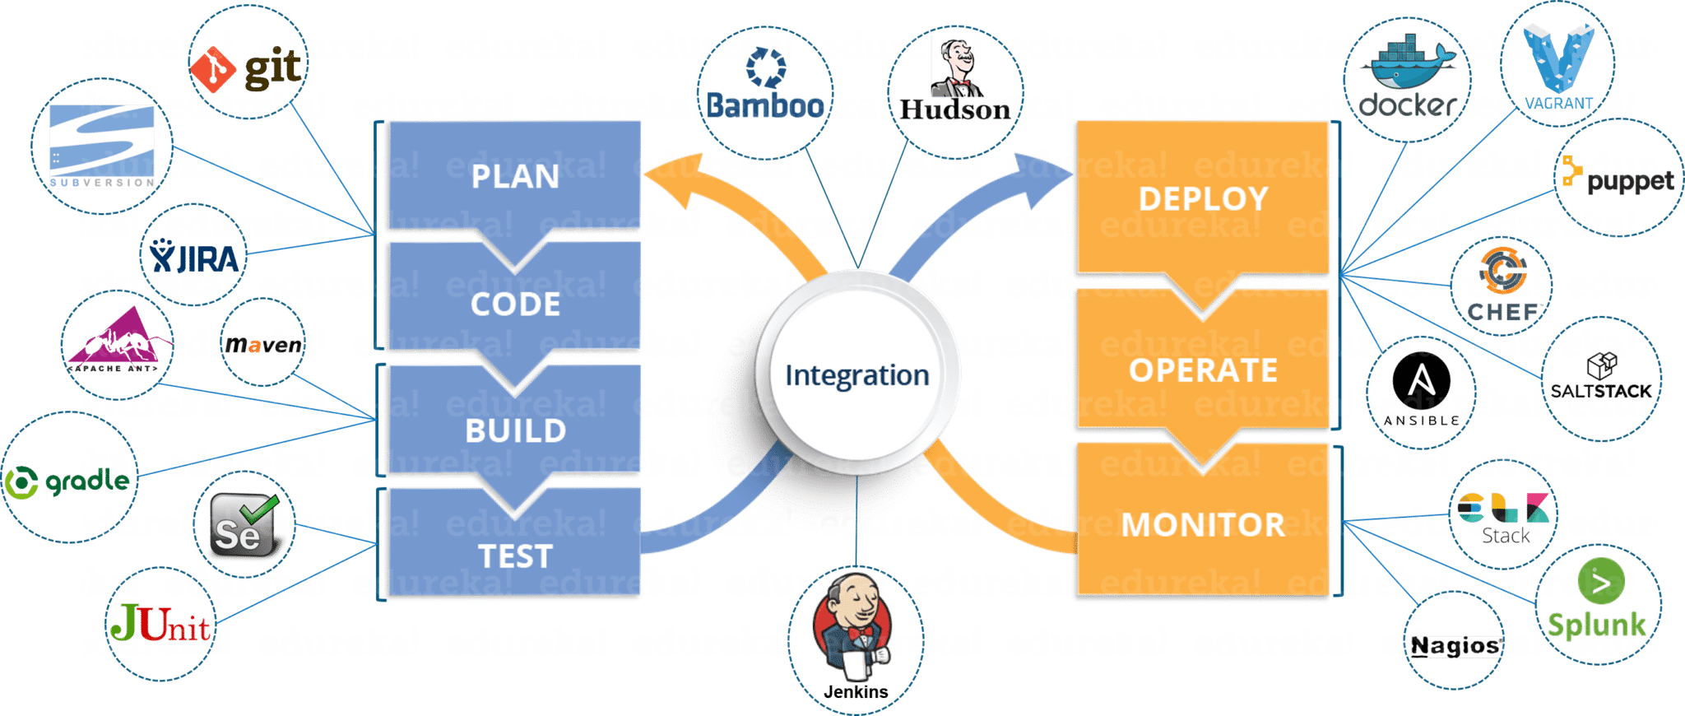
DevOps Tools

Slide 16
Agile & DevOps
Agile | DevOps
Emphasize breaking down barriers between developers and management. | DevOps is about software deployment and operation teams.
Addresses gap between customer requirements and development teams. | Addresses the gap between development and Operation team
Focuses more on functional and non-functional readiness | It focuses operational and business readiness.
Agile development pertains mainly to the way development is thought out by the company. | DevOps emphases on deploying software in the most reliable and safest ways which aren't necessarily always the fastest.
Agile development puts a huge emphasis on training all team members to have varieties of similar and equal skills. So that, when something goes wrong, any team member can get assistance from any member in the absence of the team leader. | DevOps, likes to divide and conquer, spreading the skill set between the development and operation teams. It also maintains consistent communication.
Agile development manages on "sprints. It means that the time table is much shorter (less than a month) and several features are to be produced and released in that period. | DevOps strives for consolidated deadlines and benchmarks with major releases, rather than smaller and more frequent ones.

Slide 17
DevOps Stages

Slide 18
Continuous Integration
Continuous integration is the practice of quickly integrating newly developed code with the main body of code that is to be released. Continuous integration saves a lot of time when the team is ready to release the code.
DevOps didn’t come up with this term. Continuous integration is an agile engineering practice originating from the Extreme Programming methodology. The terms been around for a while, but DevOps has adopted this term because automation is required to successfully execute continuous integration. Continuous integration is often the first step down the path toward DevOps maturity.
The continuous integration process from a DevOps perspective involves checking your code in, compiling it into usable (often binary executable) code and running some basic validation testing.

Slide 19
Continuous Delivery
Continuous delivery is an extension of continuous integration [DevOps stage 2]. It sits on top of continuous integration. When executing continuous delivery, you add additional automation and testing so that you don’t just merge the code with the main code line frequently, but you get the code nearly ready to deploy with almost no human intervention. It’s the practice of having the code base continuously in a ready-to-deploy state.

Slide 20
Continuous Deployment
Continuous deployment, not to be confused with continuous delivery [DevOps nirvana], is the most advanced evolution of continuous delivery. It’s the practice of deploying all the way into production without any human intervention.
Teams that utilize continuous delivery don’t deploy untested code; instead, newly created code runs through automated testing before it gets pushed out to production. The code release typically only goes to a small percentage of users and there’s an automated feedback loop that monitors quality and usage before the code is propagated further.
There are a very small number of companies that are truly practicing continuous deployment. Netflix, Etsy, Amazon, Pinterest, Flicker, IMVU and Google are popular examples of companies doing continuous deployment.
While DevOps nirvana is often not the end goal for most enterprises, they often focus on moving towards continuous delivery.

Slide 21
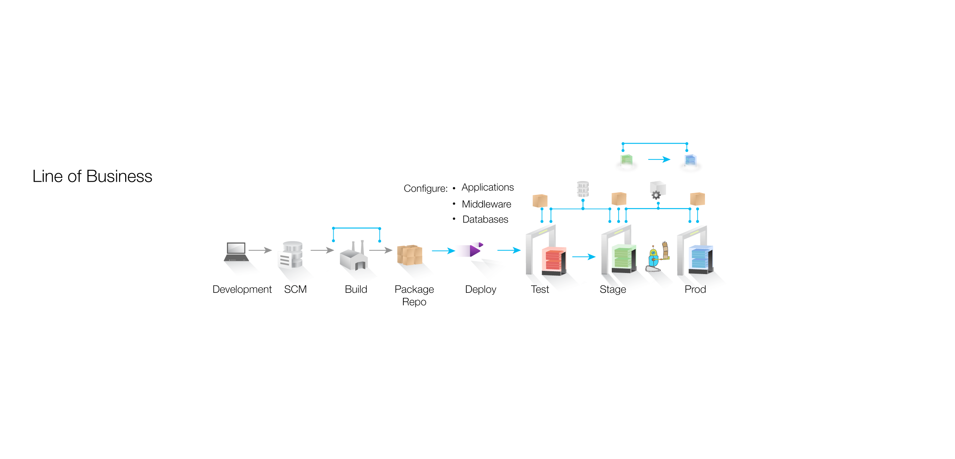
VIEW OF TOOLS IN A DEVELOPMENT PIPELINE
Ant,
Gradle,
Make,
Maven
jUnit,
Selenium,
AntUnit
DbUnit
INFRASTRUCTURE
Chef,
Puppet
Dockers, Vagrant
Git,
SVN
Continuous Integration
Continuous Deployment and Delivery
Jenkins for CI and CD
Notes:
A picture depicting a typical Development pipeline. The tools which assist in each stage of development process is also indicated.

Slide 22
Introduction to DevOps
Software Development
DevOps Life Cycle
DevOps Tools
DevOps Stages

